Slide 1

Cloud Storage Privacy: Triple Layer Defense with Fog
by
Jyothi J
Roll No. 204G1A3315
Poojitha Reddy N
Roll No. 204G1A3334
Bharath Kumar G
Roll No. 204G1A3307
Sreekanth K
Roll No. 204G1A3352
Under the guidance of
Mr. B. Sreedhar, M.Tech.,(Ph.D)
Assistant Professor
Department of Computer Science and Engineering (AI&ML)
Srinivasa Ramanujan Institute of Technology
Autonomous
Rotarypuram Village, B K Samudram Mandal, Ananthapuramu – 515701.
2023-2024

Slide 2

Contents
Abstract
Introduction
Literature survey
Existing System
Proposed system
Planning and Design
Implementation
Output
Paper submitted proof
References

Slide 3
Abstract
In recent years, we are witnessing the development of cloud computing technology. With the explosive growth of unstructured data, cloud storage technology is vastly used and it needs better development. However, in the current storage schema, the user’s data is totally stored in cloud servers. The stored user’s data is protected using encryption technology that can avoid attacks from outside the servers. But this encryption technology cannot avoid attacks from the insiders of cloud servers. To overcome this problem, we propose a three-layer storage model based on Fog computing which takes care of cloud storage and protects the privacy of data. The proposed model can both take full advantage of Cloud storage and protect the privacy of data.
The Hash-Solomon code algorithm is designed to divide data into different parts, then we can put the data in the small blocks local machine and fog server to protect privacy. And also we deploy a bucket-based algorithm, coupled with the BCH code algorithm, to enhance data security. Moreover, based on computational intelligence, this algorithm can compute the distribution proportion stored in cloud, fog, and local machine respectively.

Slide 4
Problem Statement
As we know, in this era of the digital world there is a rapid growth and demand for cloud servers. However, on the other hand, concerns regarding data privacy and security have emerged due to potential breaches, unauthorized access, and data leaks.
To address these challenges, fog computing has come into the picture that can enhance privacy and reduce the risk of data leaks and data loss.
Our project aims to develop a robust three-layer privacy protection model that encompasses three distinct layers: cloud, fog, and user-end devices. Its main aim is to safeguard sensitive user data throughout its lifecycle.

Slide 5
Objectives of Project
To develop Edge based layer that enhance Privacy protection for data stored in cloud Servers and optimized access of cloud storage utilization.
To implement Hash-Solomon code algorithm, Attribute-based Encryption (ABE) and enhance security through OTP generation.

Slide 6
Literature survey for first objective
The objective of enhancing privacy protection, preventing unauthorized access, and giving users have control over their data in fog computing is supported by various research sources. Notable papers and studies in this field include . "A Survey on Privacy and Security in Internet of Things: Fog Computing, Frameworks, and Approaches (2019)" This comprehensive survey paper provides an extensive overview of privacy and security issues in the IoT and Fog Computing domains. It covers various approaches and frameworks for enhancing data privacy, including: Data Encryption, Access control, Anonymization, secure data aggregation.
The "Edge Computing and the Internet of Things for Privacy-Preserving Video Surveillance" (2020) This paper, while focusing on video surveillance, offers insights into privacy-preserving techniques at the edge of IoT networks, including: Local Processing and Analysis , Object Detection and Recognition , Data Redaction and Masking , User controlled data access. These techniques from the two papers provide a foundation for enhancing privacy and security in the context of edge (fog) computing for IoT networks, particularly when dealing with real-time applications such as video surveillance.

Slide 7
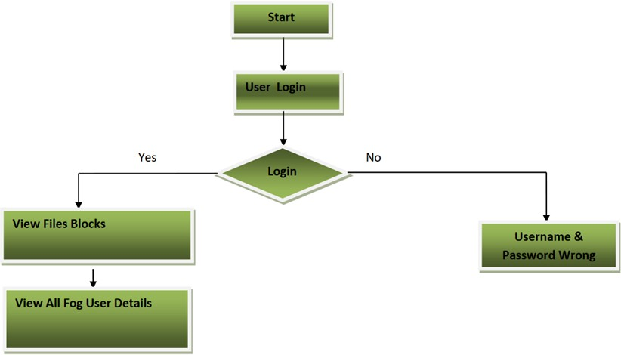
Objective-1 (Design)

Slide 8
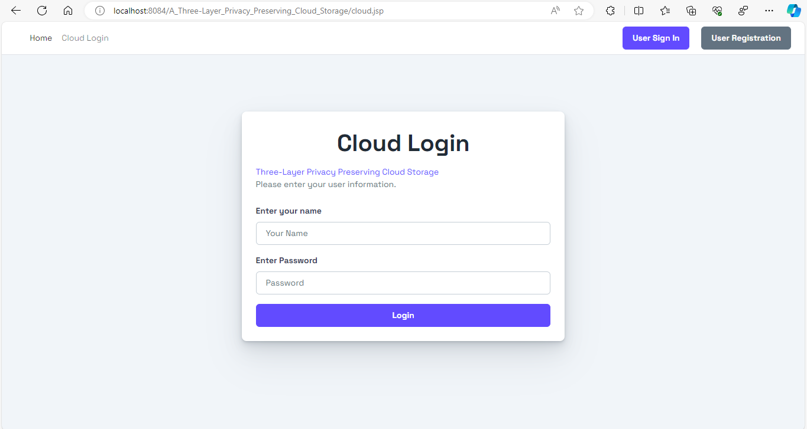
Objetive-1 (Implementation)

Slide 9
Literature survey for second objective
The Hash-Solomon code algorithm is a promising approach for optimizing cloud storage utilization. While not extensively covered in current literature, the principles of erasure coding, of which Hash-Solomon is a variant, have been widely explored. "HAIL: A High-Availability and Integrity Layer for Cloud Storage" by Corbett et al. (2013) presents the foundation for erasure coding in cloud storage.
To explore Hash-Solomon specifically, "Hash-Solomon: Flexible Caching and Provable Deduplication" by Sathiamoorthy et al. (2013) is a seminal paper. However, there may be limited literature directly focused on Hash-Solomon, so it's essential to leverage broader erasure coding research to understand its potential and limitations for partitioning data based on importance and optimizing cloud storage utilization.

Slide 10
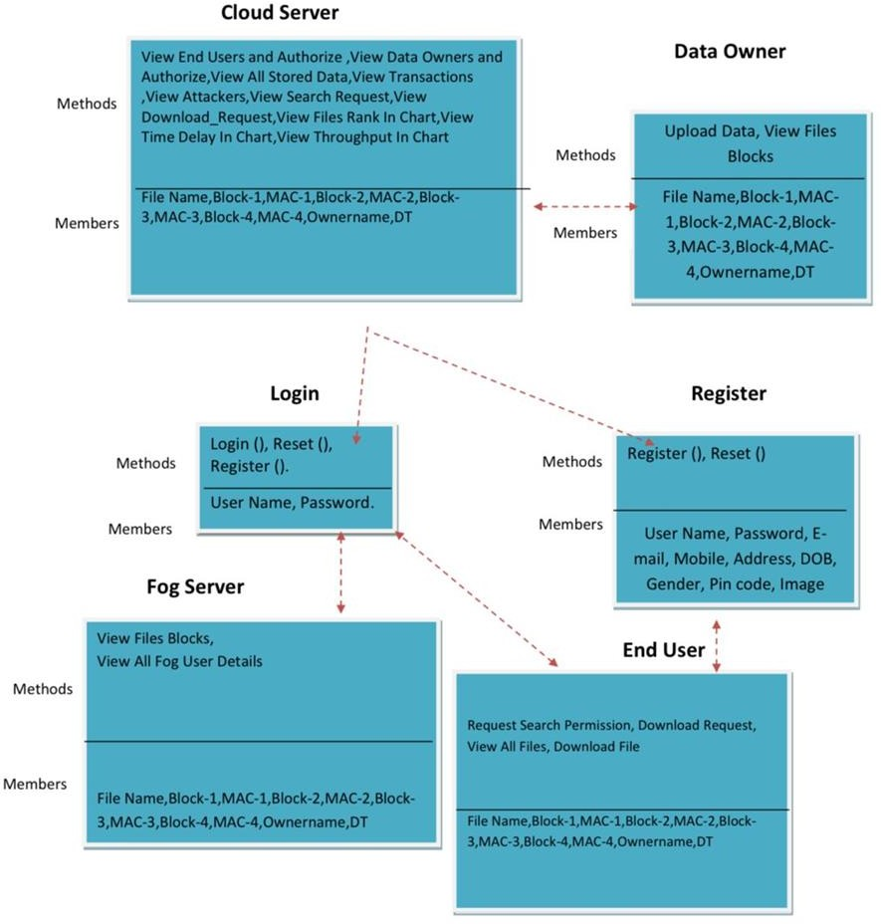
Objective-2 (Design)
Fig: System Architecture

Slide 11
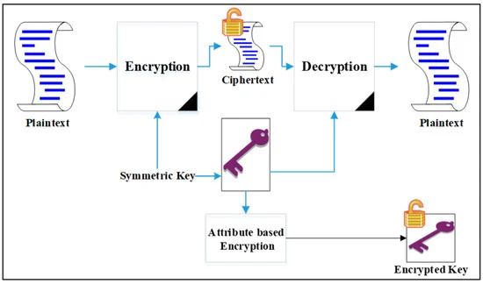
File uploading and Retrieving process
Fig : Block diagram of Attribute based Encryption

Slide 12
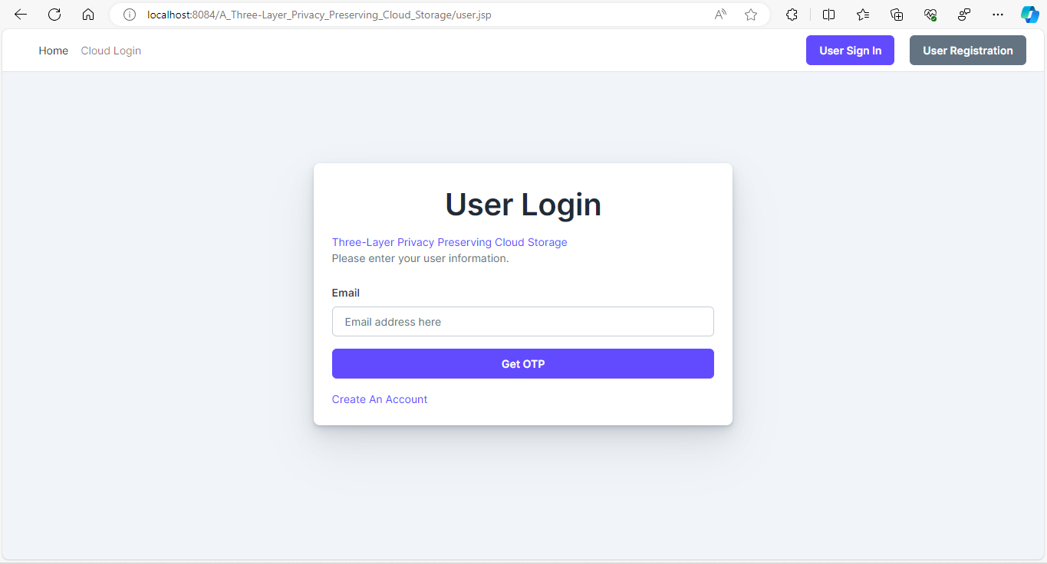
Objective-2 (Implementation)

Slide 13
Proposed System
The proposed system involves the development of a novel architecture that integrates cloud computing with fog computing to establish a three-layer privacy protection mechanism. This architecture will include encryption algorithms, access control policies, and secure data processing techniques and ensure comprehensive data privacy throughout the cloud-fog-end device ecosystem.
The proposed system can both take full advantage of cloud storage and protect the privacy of data. Here we will be using :
1. Hash- Solomon Code Algorithm
2. Attribute-based Encryption
3. Bose-Chaudhuri-Hocquenghem
4. Bucket Framework

Slide 14
Continued..
Hash- Solomon code algorithm is mainly designed for dividing the data into different parts. Here the data is divided and stored in the encrypted blocks of matrix form.
Attribute-based encryption (ABE) is used to control access to data. ABE is a cryptographic technique that allows data to be encrypted in such a way that only users with specific attributes are able to decrypt and access it. So,the content of the data remains confidential.
Bose-Chaudhuri-Hocquenghem (BCH) codes form a class of cyclic error-correcting codes. This algorithm is used to detect and correct errors in data transmission and storage processes.
Bucket Framework is specially designed for the user to retrieve the data if the data has been lost or modified by a third party. Bucket acts as a mirror, whatever data has been entered by the user it will be automatically stored in it.

Slide 15
Hardware and software requirements
OS - Windows 10 above
Processor - Dual Core
RAM - 4 GB(min)
Storage - Cloud
Front end - JSP, HTML, CSS, JS
Back end - Java, MySQL
IDE - NetBeans

Slide 16
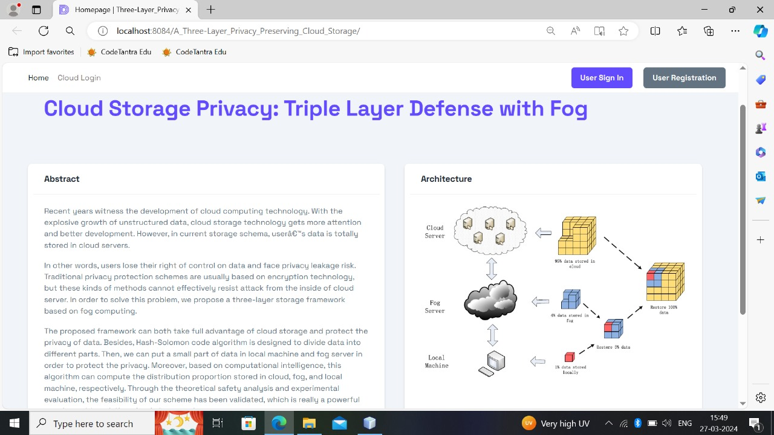
Output

Slide 17
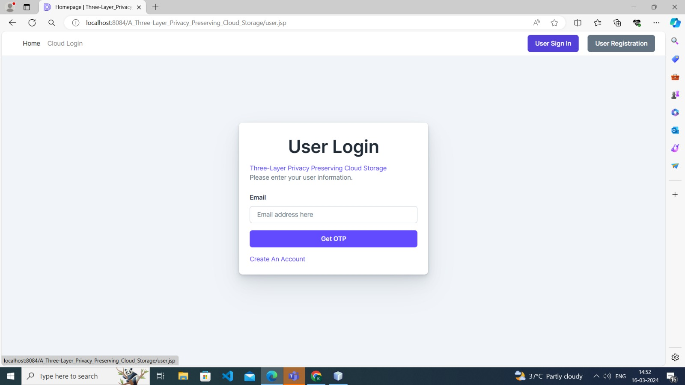
Output

Slide 18
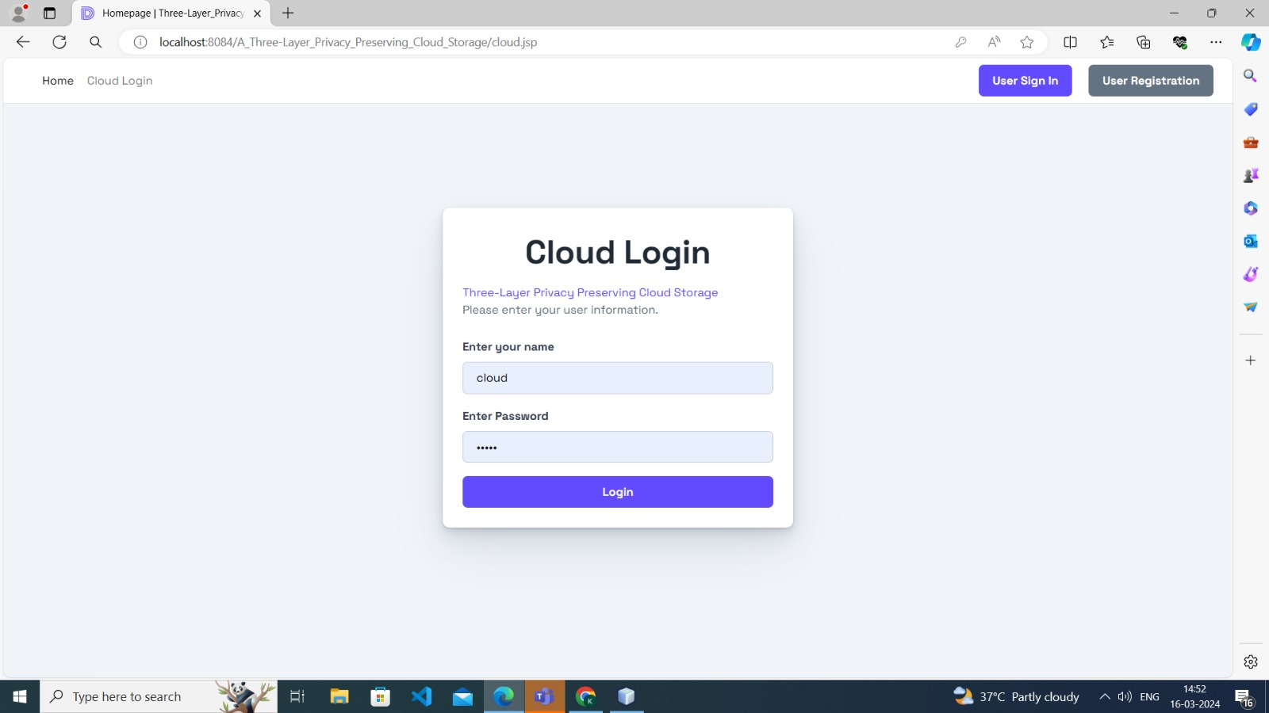
Output

Slide 19

Output

Slide 20
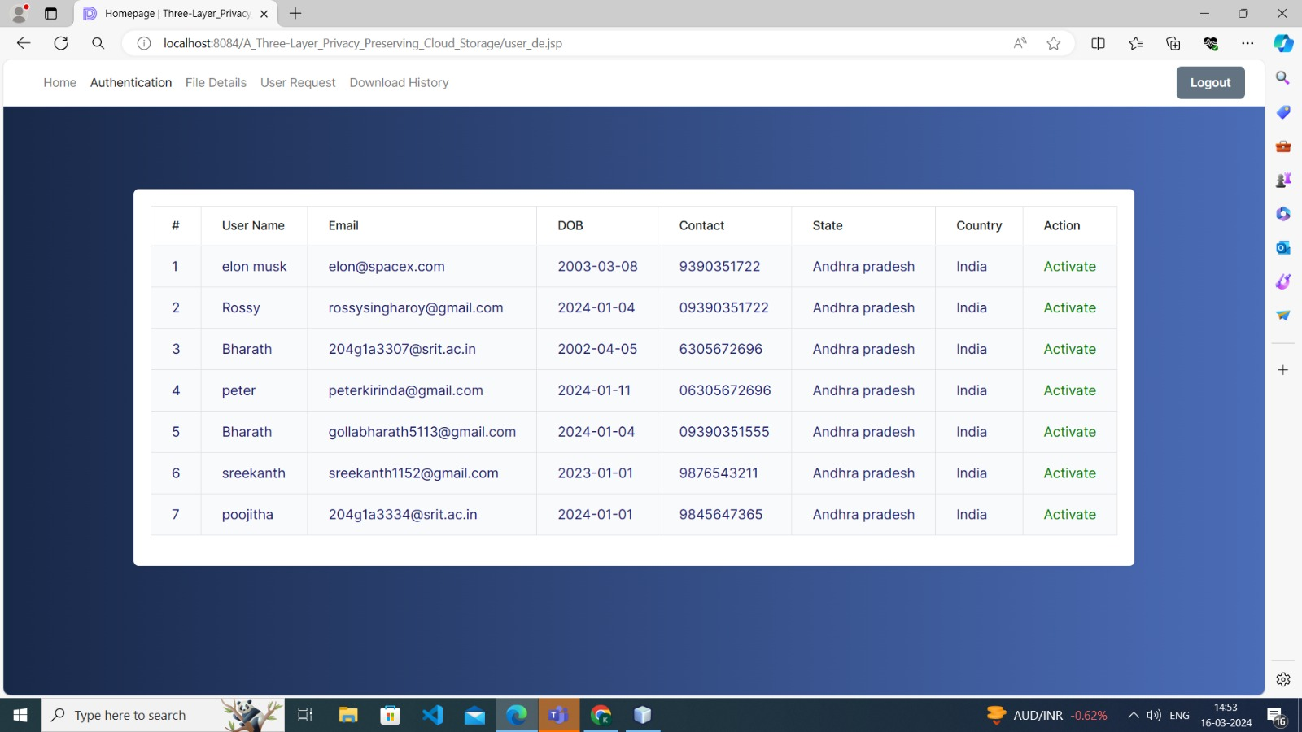
Output

Slide 21
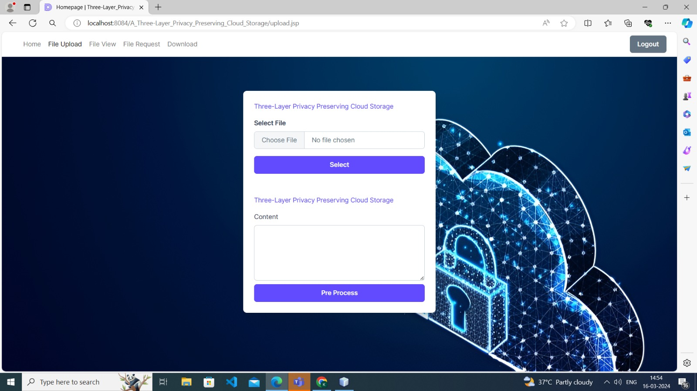
Output

Slide 22
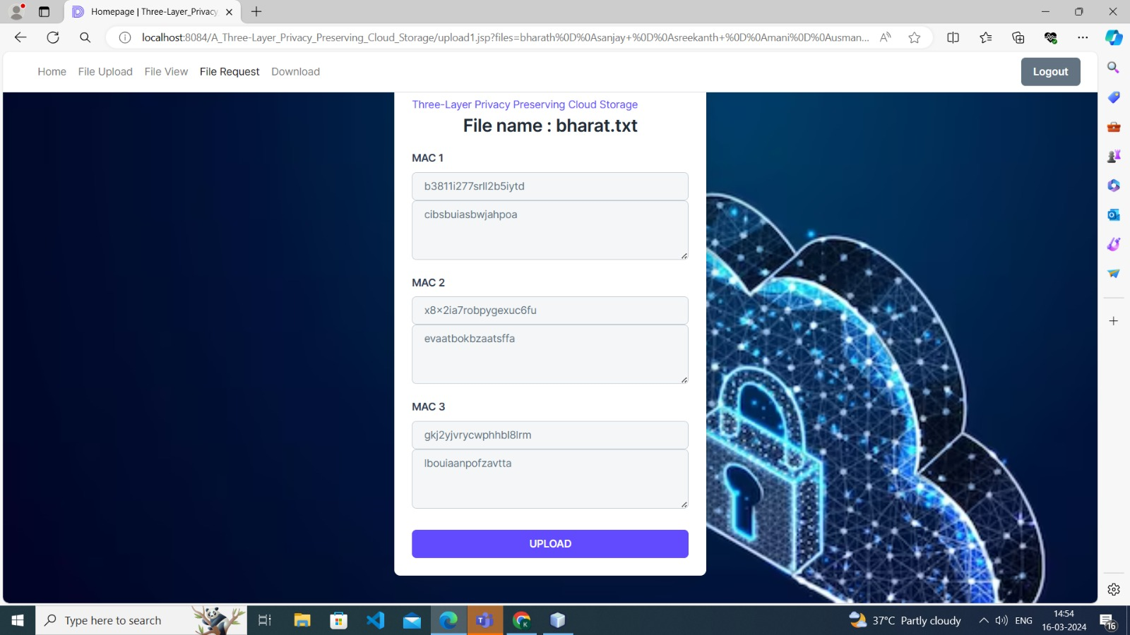
Output

Slide 23
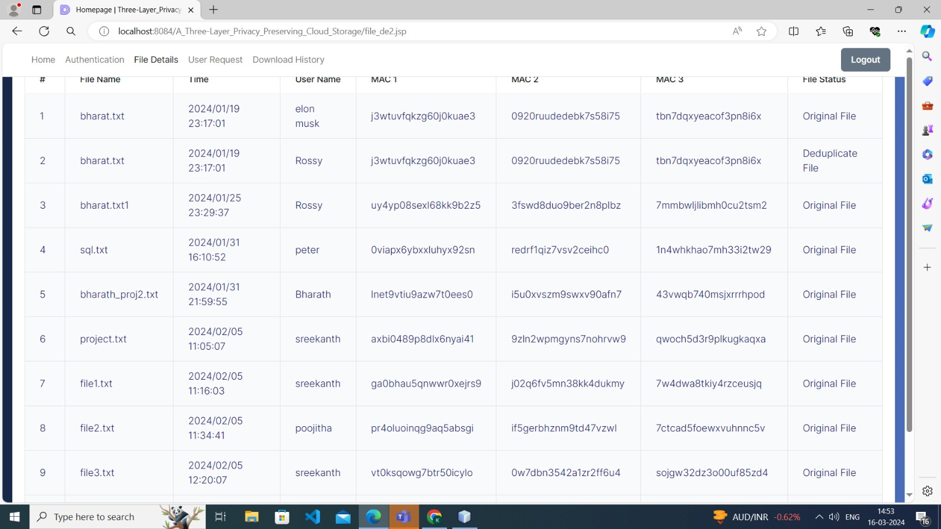
Output

Slide 24
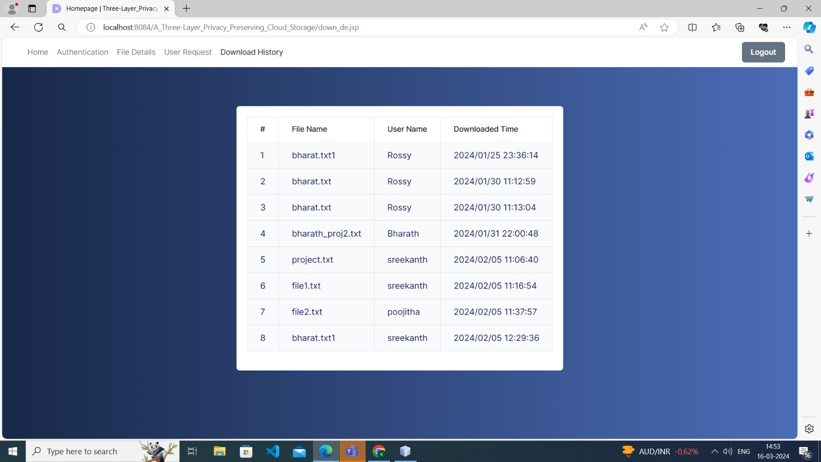
Output

Slide 25
References
[1]. Kavyashree M, Shoba, Nagashree, Nischitha D Raj “A Three-Layer Privacy Preserving Cloud Storage Scheme Based on Computational Intelligence in Fog Computing” International Research Journal of Engineering and Technology (IRJET)., Vol: 07 Issue: 06 | June 2020.
[2]. Keke Gai, Member, IEEE, Liehuang Zhu, Member, IEEE, Meikang Qiu, Senior Member, IEEE, Kai Xu, Kim-Kwang Raymond Choo, Senior Member, IEEE, “Multi-Access Filtering for Privacy-preserving Fog Computing”, IEEE Transactions on Dependable and Secure Computing, PP(99):1, 2019.
[3]. M A Manazir Ahsan, Student Member, IEEE, Ihsan Ali, Student Member, IEEE, Muhammad Imran, Mohd Yamani Idna Bin Idris, Suleman Khan, Anwar Khan, "A Fog-centric Secure Cloud Storage Scheme” , 2377-3782 (c) 2018 IEEE.

Slide 26
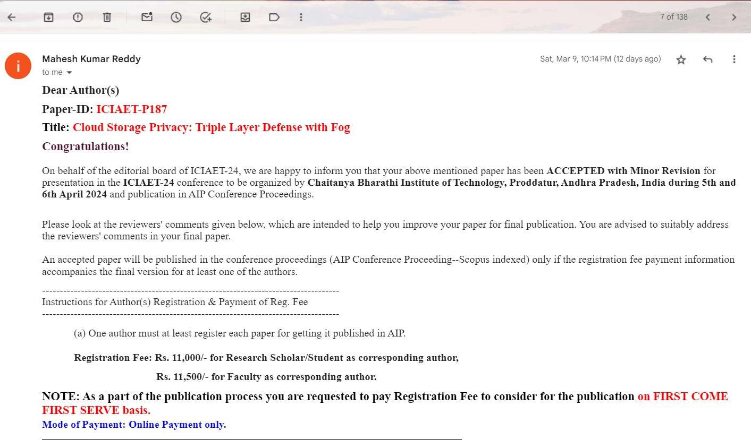
Paper Submitted Proof

Slide 27
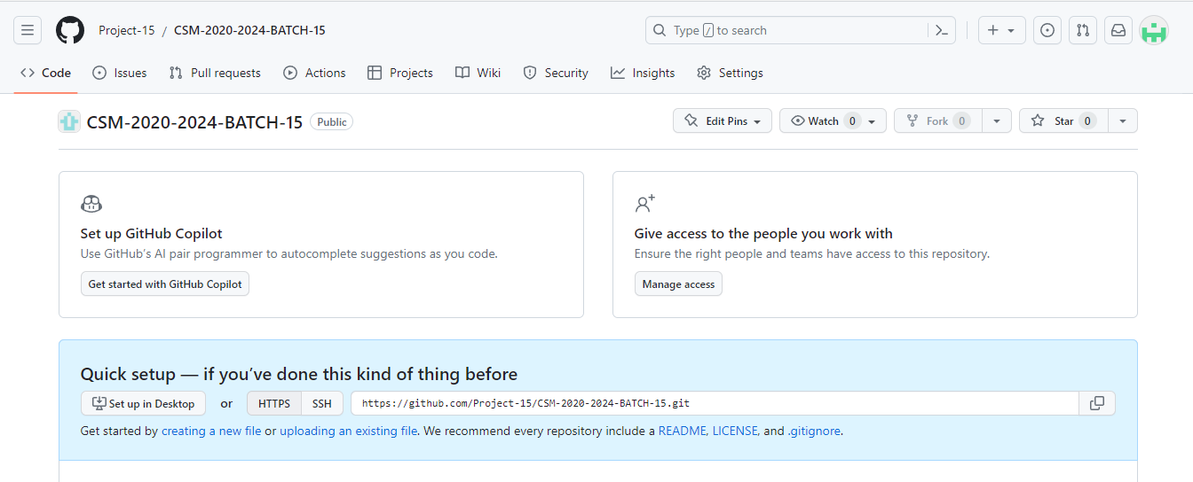
Git Hub Dashboard

Slide 28
Thank you!!

